Slide 1
Stock Forecaster
Ryder Paulson & Kevin Li

Slide 2

Introduction
Create an algorithm to predict the future value of a stock
Do this via a greedy algorithm
Numeric - based on historical data
Import data via CSV
1 year of history available for free from MarketWatch
Plot with MATLAB
(Weiss)

Slide 3
Outline
Review of Literature
A review of research for the project. Mainly concerns theory around option pricing which is relevant to stock forecasting.
methodology
First, we will look at the pre-processing of the algorithm. We will then look at the forecasting equation.
results
In addition to a live demo, we will look at a selection of forecasts for Apple, TSMC, Caterpillar, and Boeing which highlight different aspects of the algorithm.
Evaluation &
Conclusion
A summary of the pros and cons of the algorithm as well as ways it may be improved.
Notes:
R

Slide 4
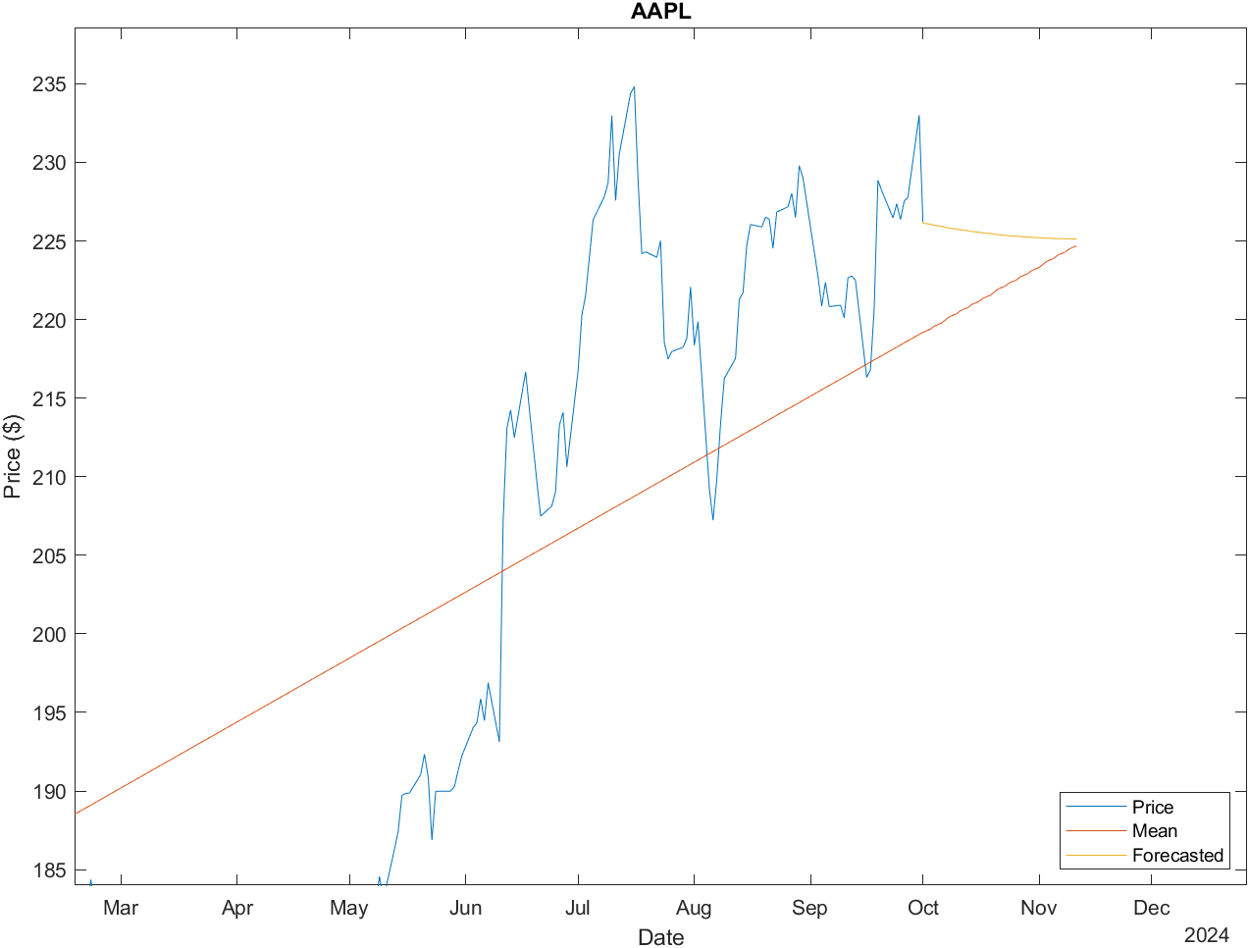
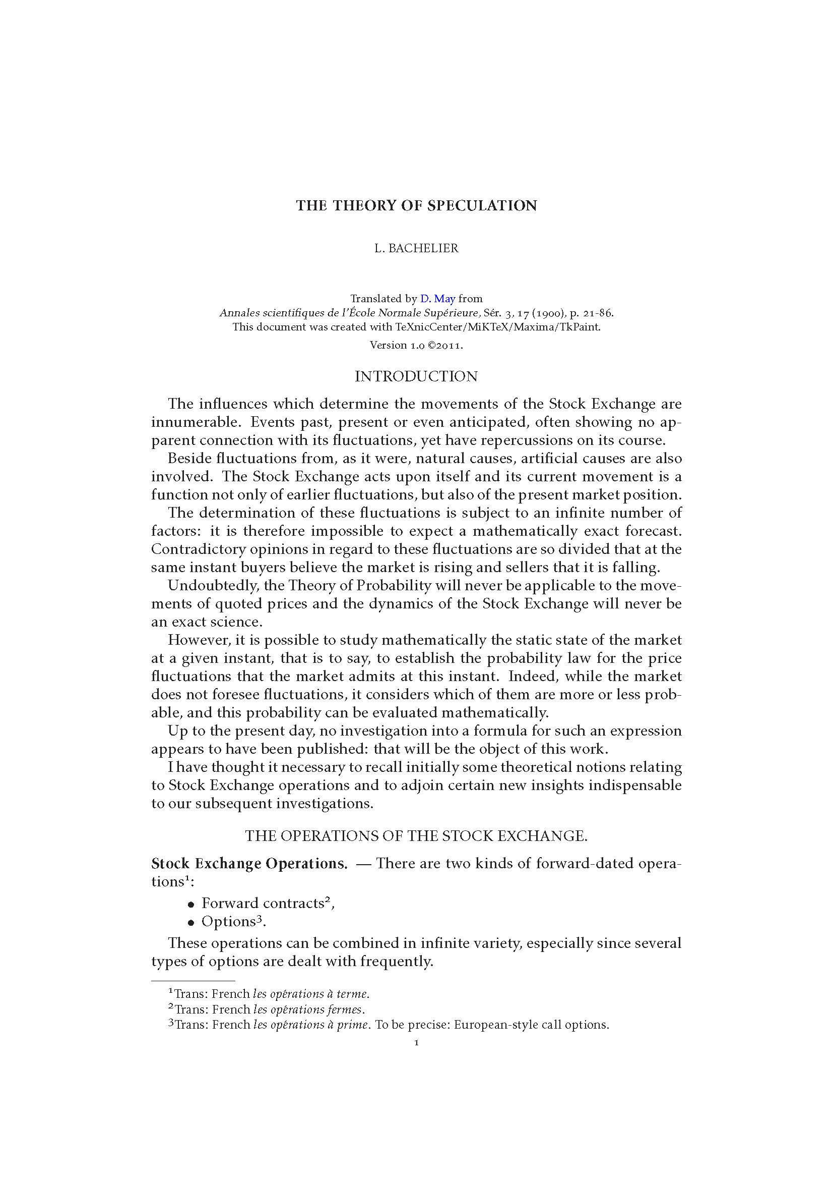
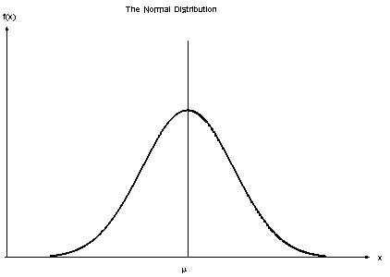
Literature Review
Options
The option to buy/sell a stock at a specific price in the future
Make/lose money based on the difference between the option price and the actual price
The radiation of probabilities
Too many variables to predict the market (Muller)
Prices are somewhat random, but radiate according to a normal distribution (Muller)
Discovered in the context of finance by Louis Bachelier (Muller)
(Bachelier)
(NIST/SEMATECH)
Notes:
R

Slide 5
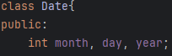
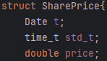
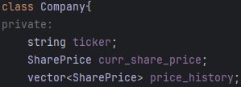
Data Strucutres
Date
Month, day, year
SharePrice
Date
Price
time_t
Company
Ticker (ex. AAPL, GOOGL)
SharePrice representing most recent stock price
Vector<SharePrice> storing price history

Slide 6
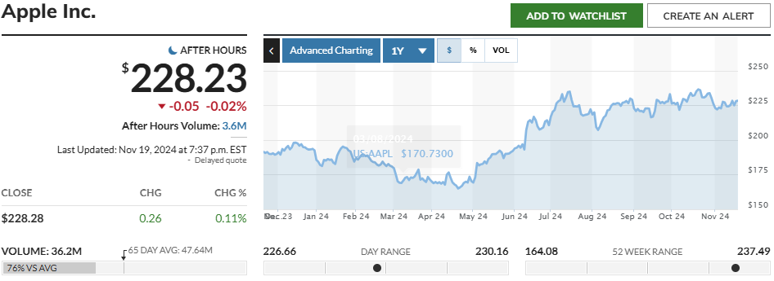
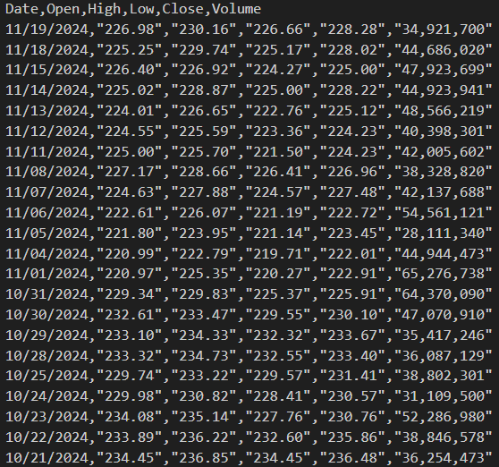
Data from MarketWatch
Data imported as CSV from Marketwatch
fstream library used for file I/O
SharePrice object created
Date
Closing value
Vector<SharePrice> stored in Company object

Slide 7
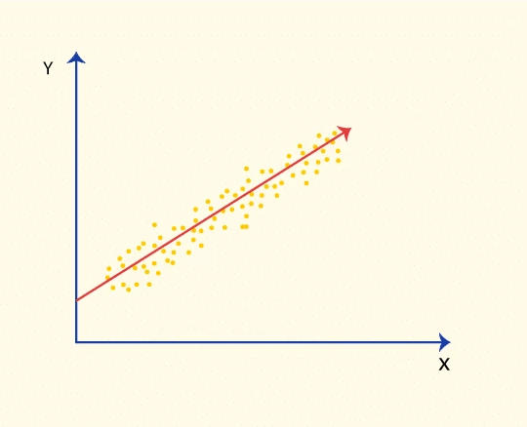
methodology
n – length of input data
m – how many values to be forecasted
Pre-processing Steps
Convert dates to ctime - O(n)
Normalize the X axis - O(n)
Set the first x value to be zero
Standard interval – O(n)
The average difference between two x value
Perform linear regression – O(n)
Forecast linear values – O(m)
Over time complexity of pre-processing:
O(n+m)
(“How Can You Calculate Linear Regression?”)
Notes:
R

Slide 8
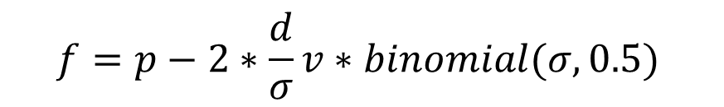
Key Terms:
Volatility (v) – The average difference between two values
Standard deviation (σ)
Deviation (d) – The difference between the previous value and the linear regression
Previous price (p) – The previous value. May be a forecasted value or a real value
Forecasted price (f)
Binomial is a random value based on a binomial distribution of σ tests with a 50% chance of success
$$f=p−2∗\frac{d}{σ}v∗binomial(σ,0.5)$$
Overall time complexity including forecasting:
O(n+m)
Notes:
R

Slide 9
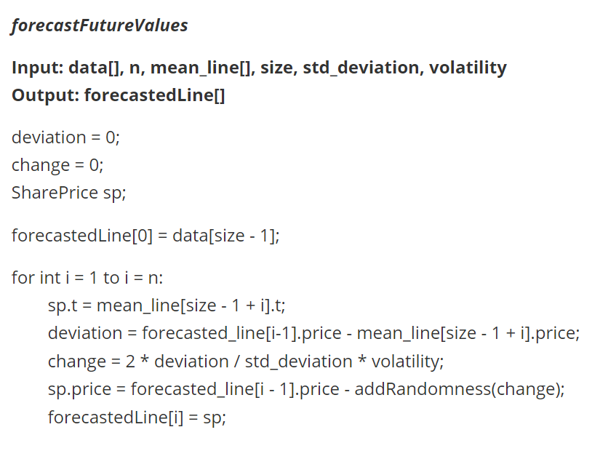
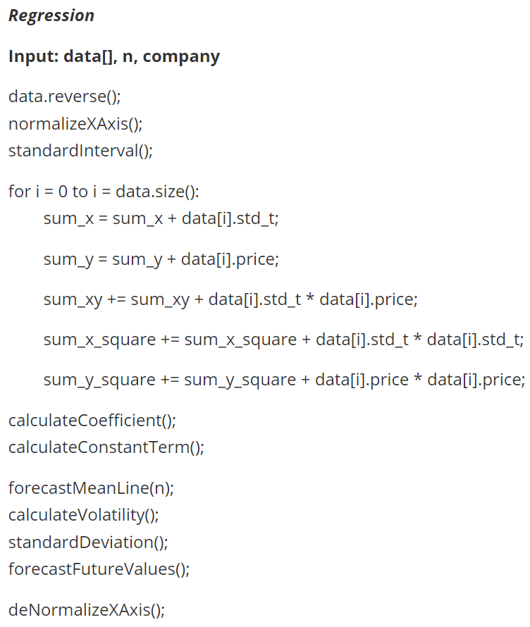
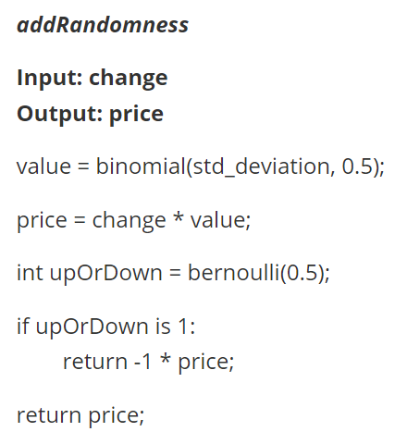
Pseudocode
Notes:
R

Slide 10
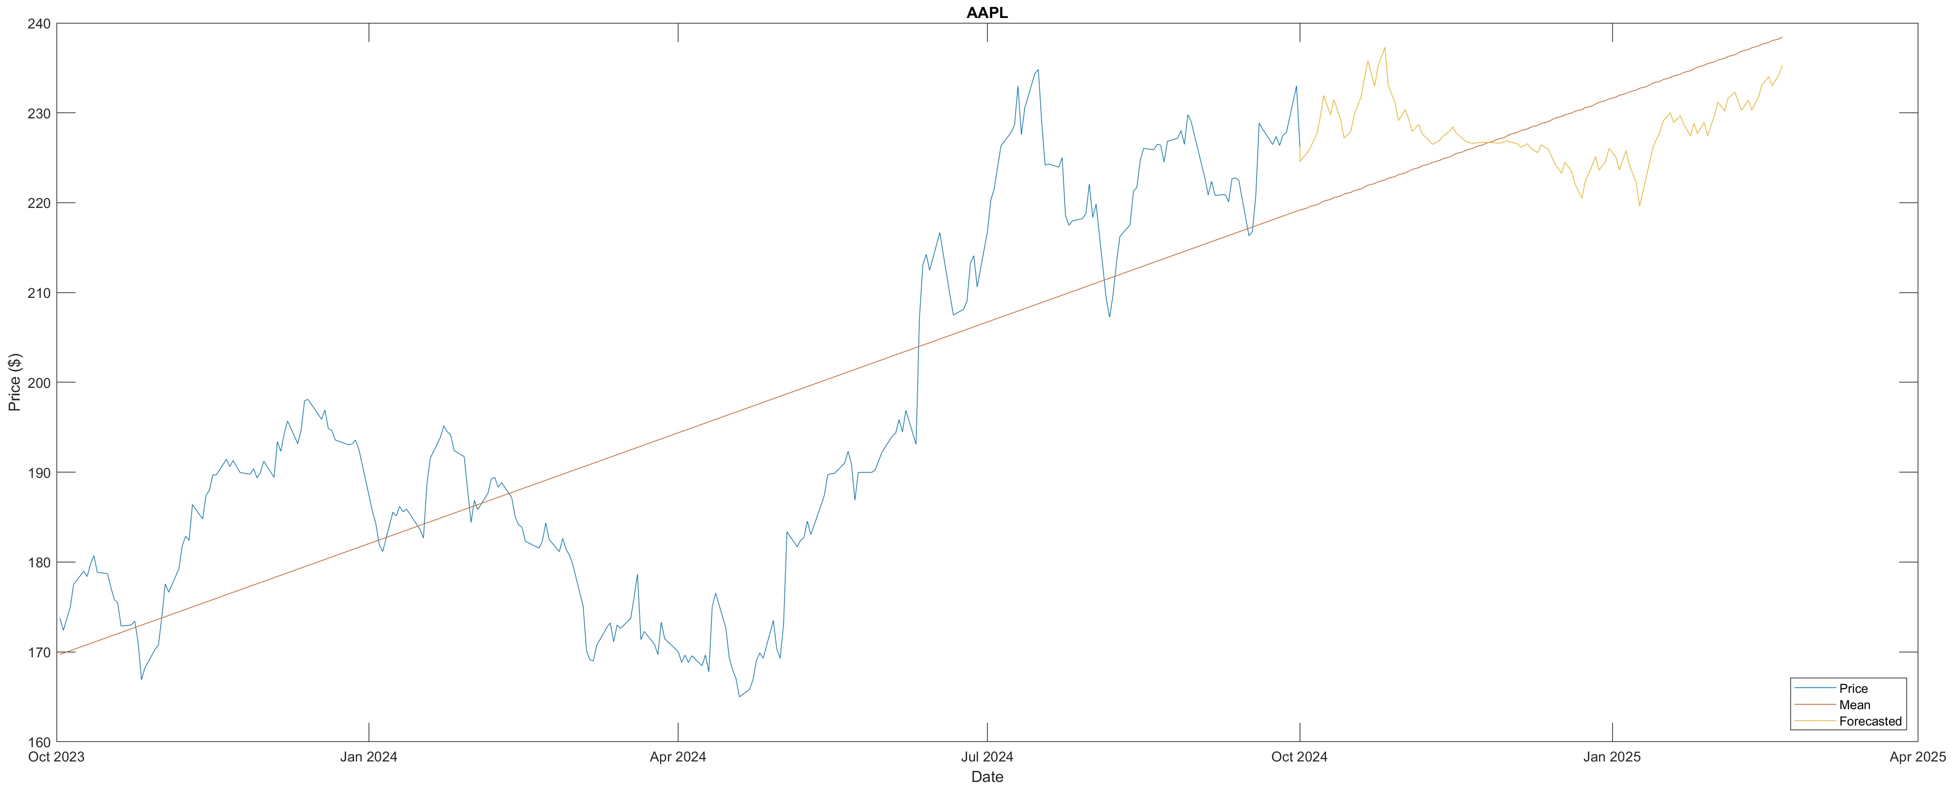
Results

Slide 11
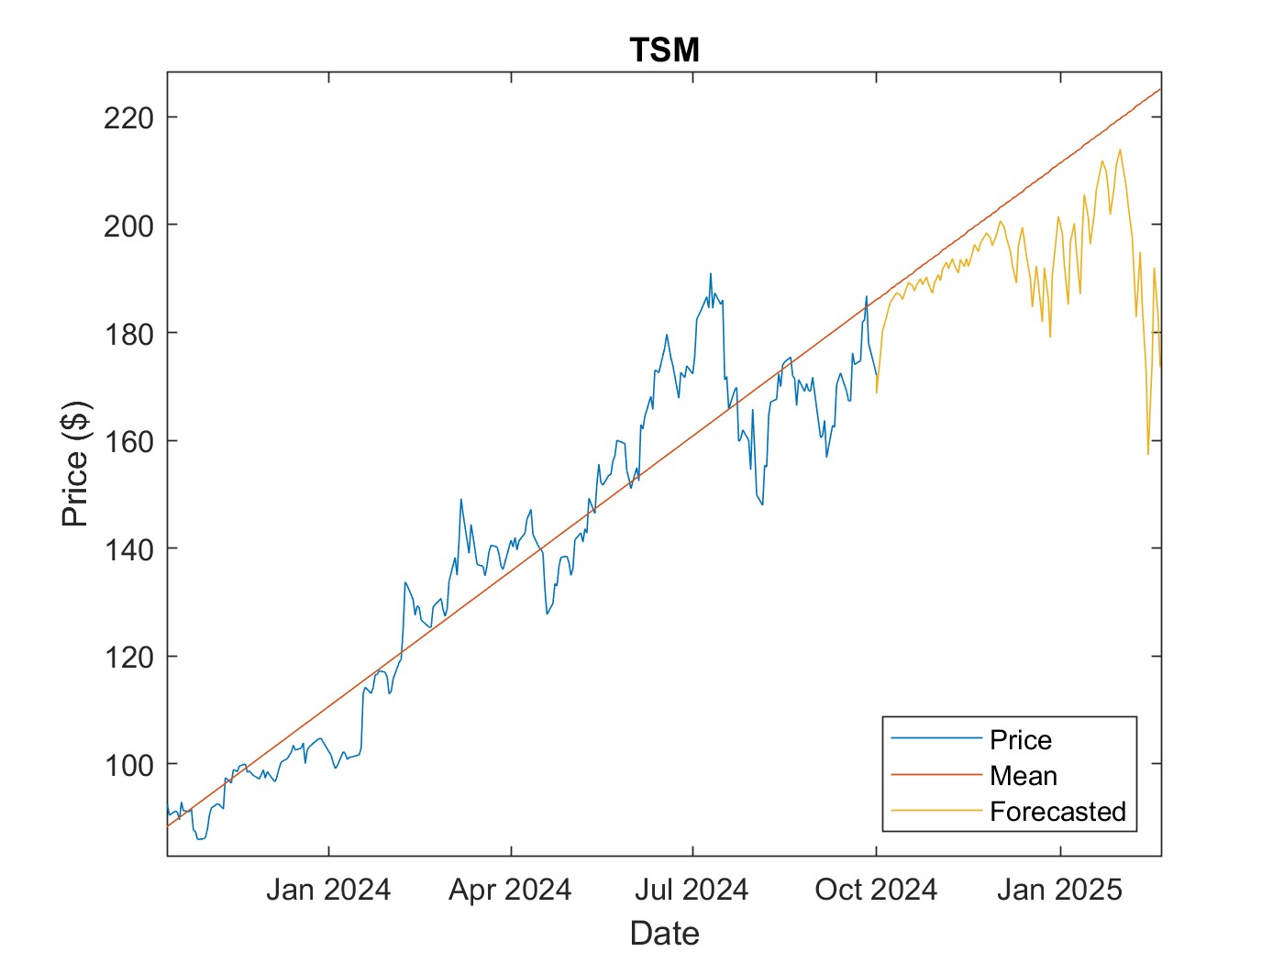
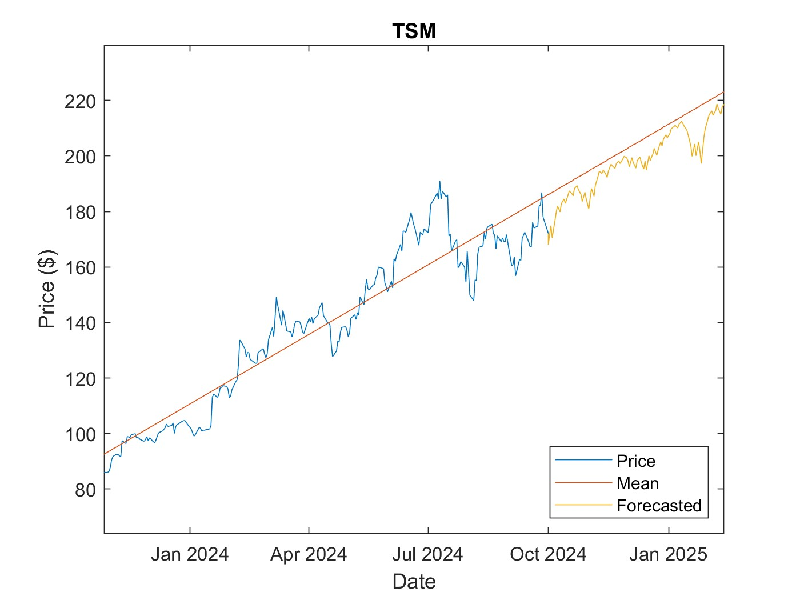

Slide 12
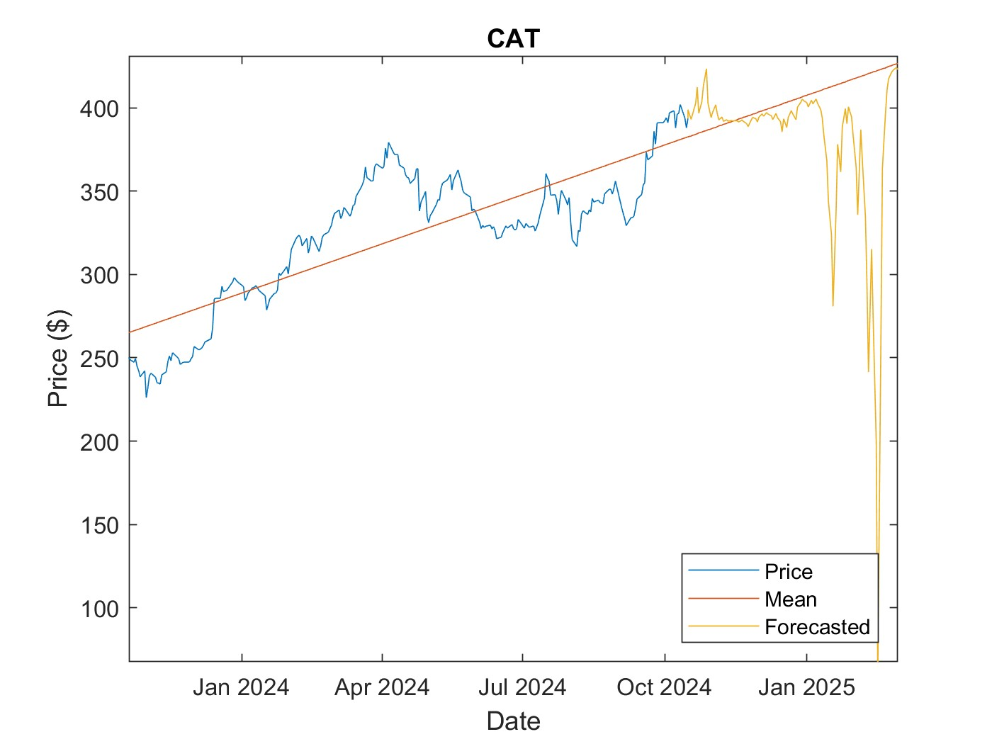
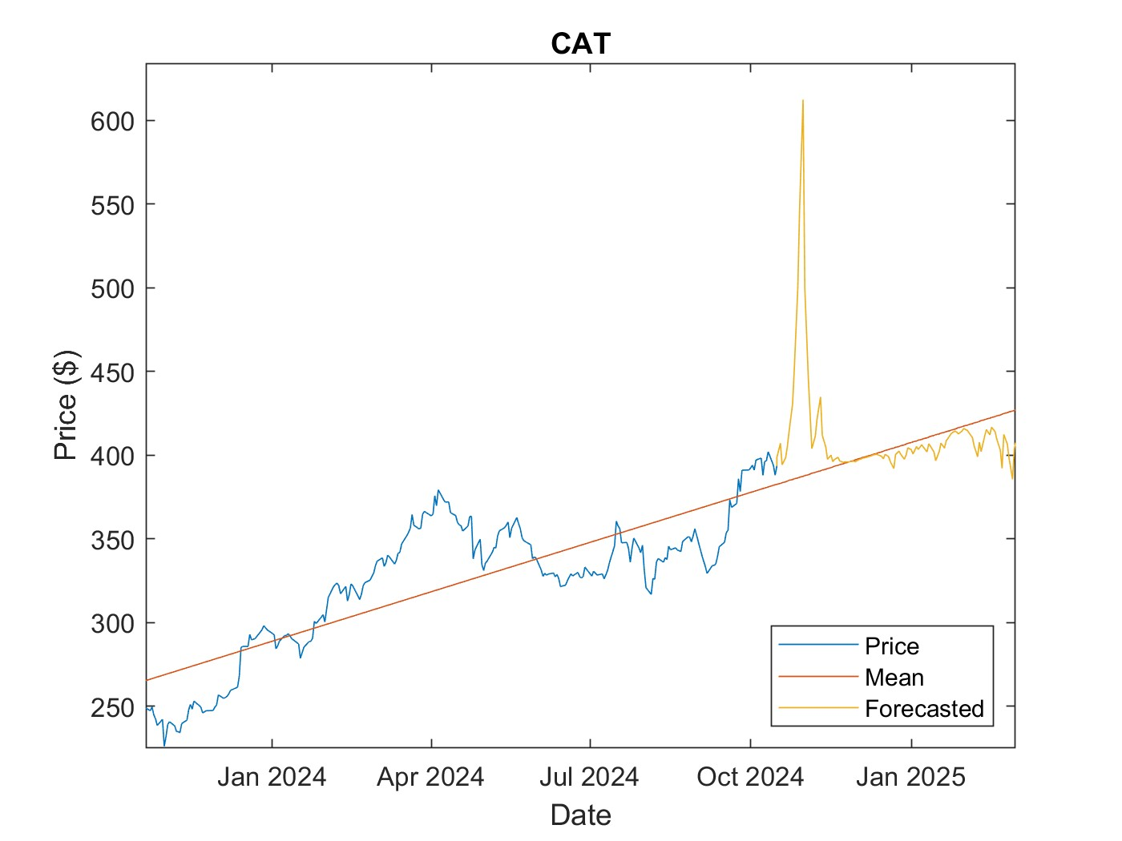
Notes:
R

Slide 13
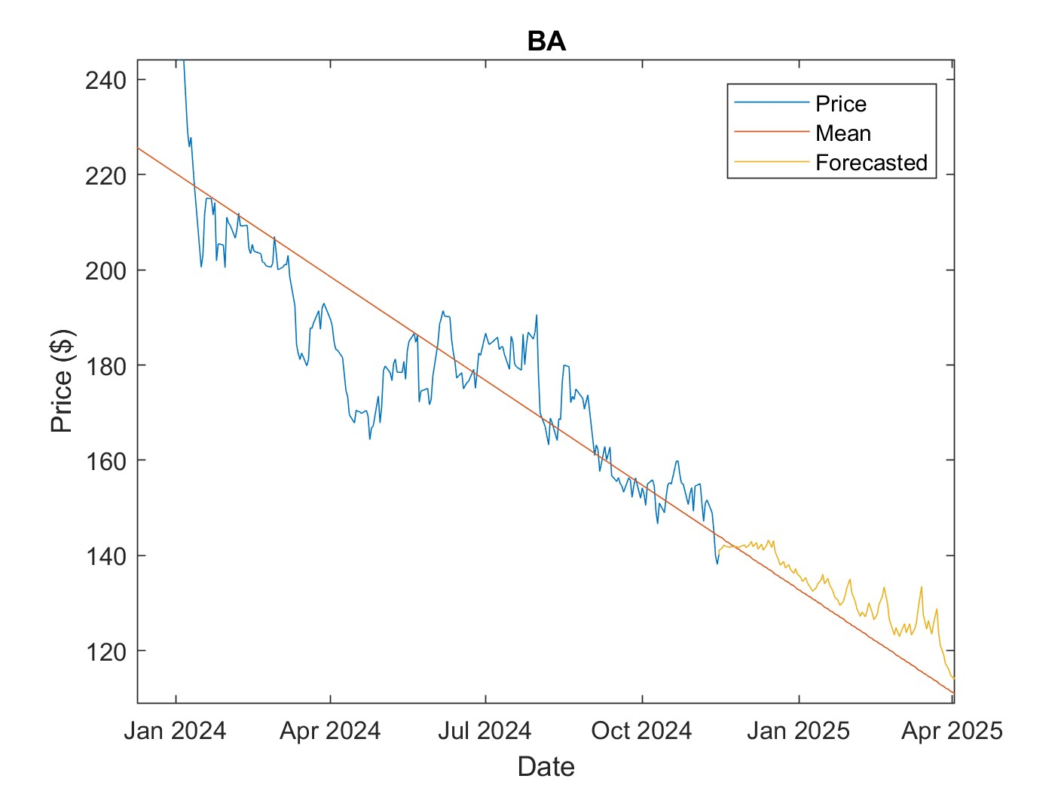
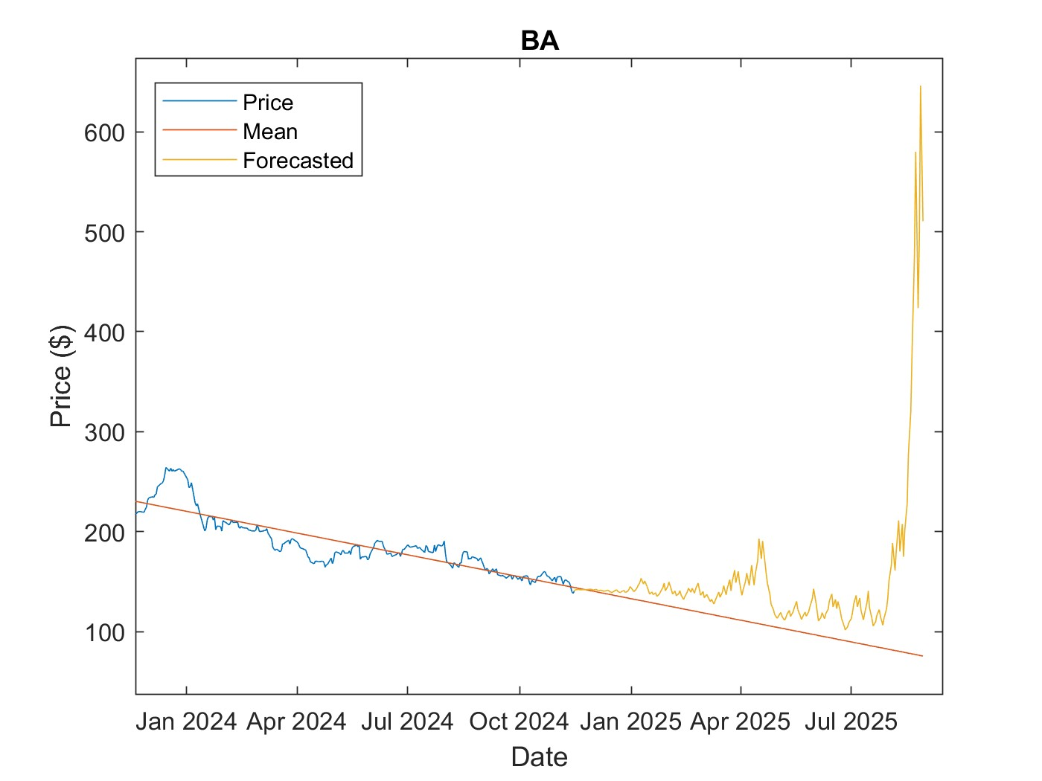
Notes:
R

Slide 14
Discussion
Capabilities
Pitfalls
Produce a forecast which tracks the trending price of the stock
Short-term predictions
No connection to companies' fundamentals
Specific price values are random
Some simulations deviate wildly from realistic values

Slide 15
Conclusion
It is difficult to predict markets
Potential Improvements
Analyze how price changes according to companies’ fiscal results
Web-scrape news and forecast based on opinions on company
Add a filter to eliminate forecasted values which deviate wildly what is realistic
Real-time self learning

Slide 16
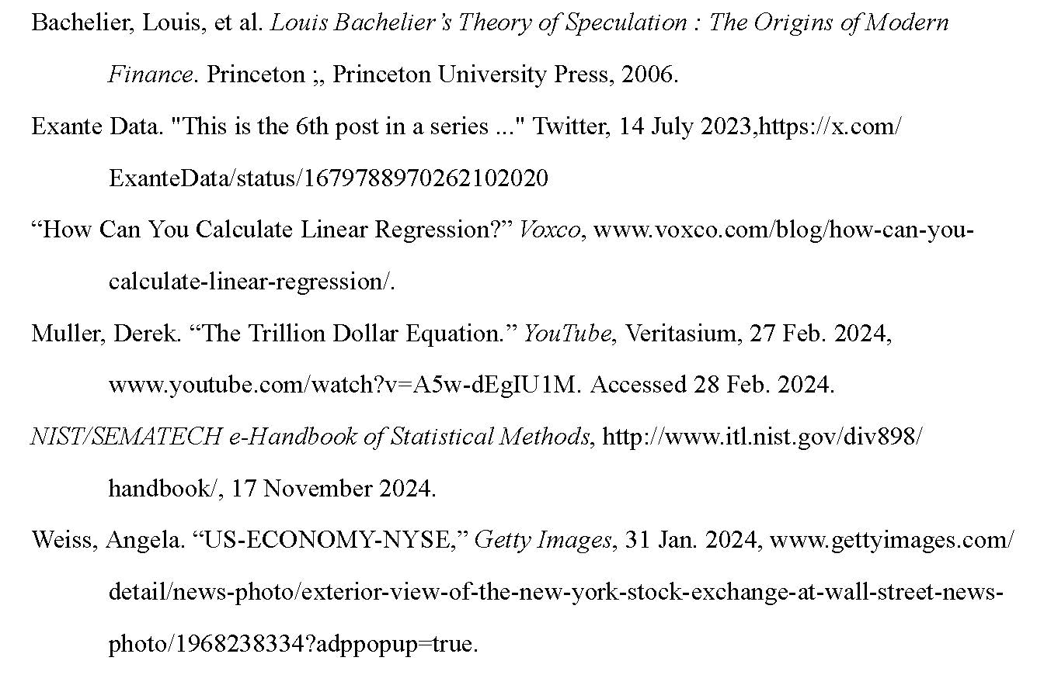
References

